Slide 1
GFNet & MetaFormer
Paper Summary
Notes:
Conference on Neuron Information Processing Systems

Slide 2
References
Rao et al – Tsinghua University, China, Global Filter Networks for Image Classification, NeurIPS 2021.
Yu et al – Sea AI Lab, Singapore, MetaFormer is Actually What You Need for Vision, CVPR 2022.

Slide 3
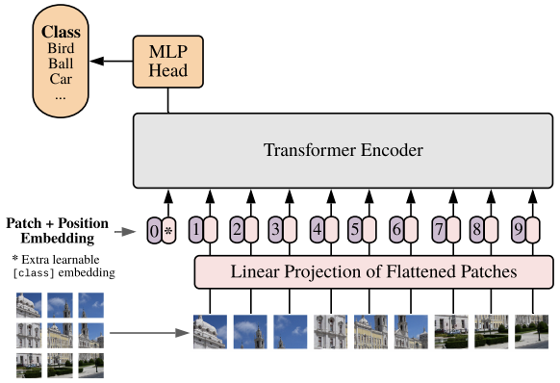
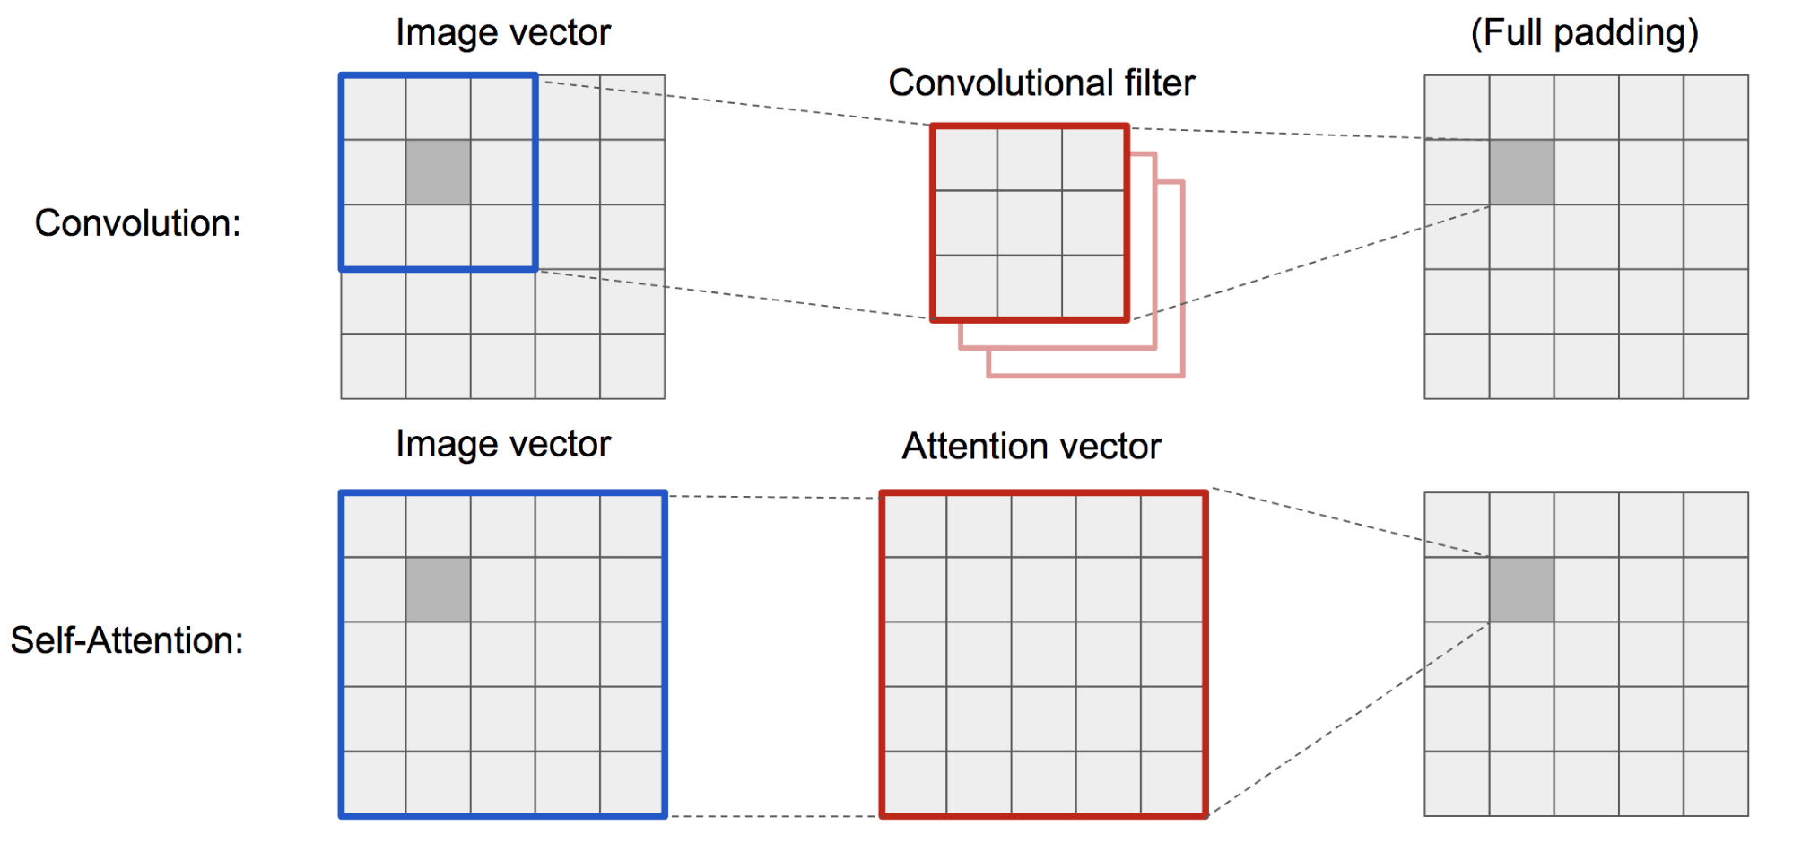
Vision Transformers
Convolution
Self-attention

Slide 4
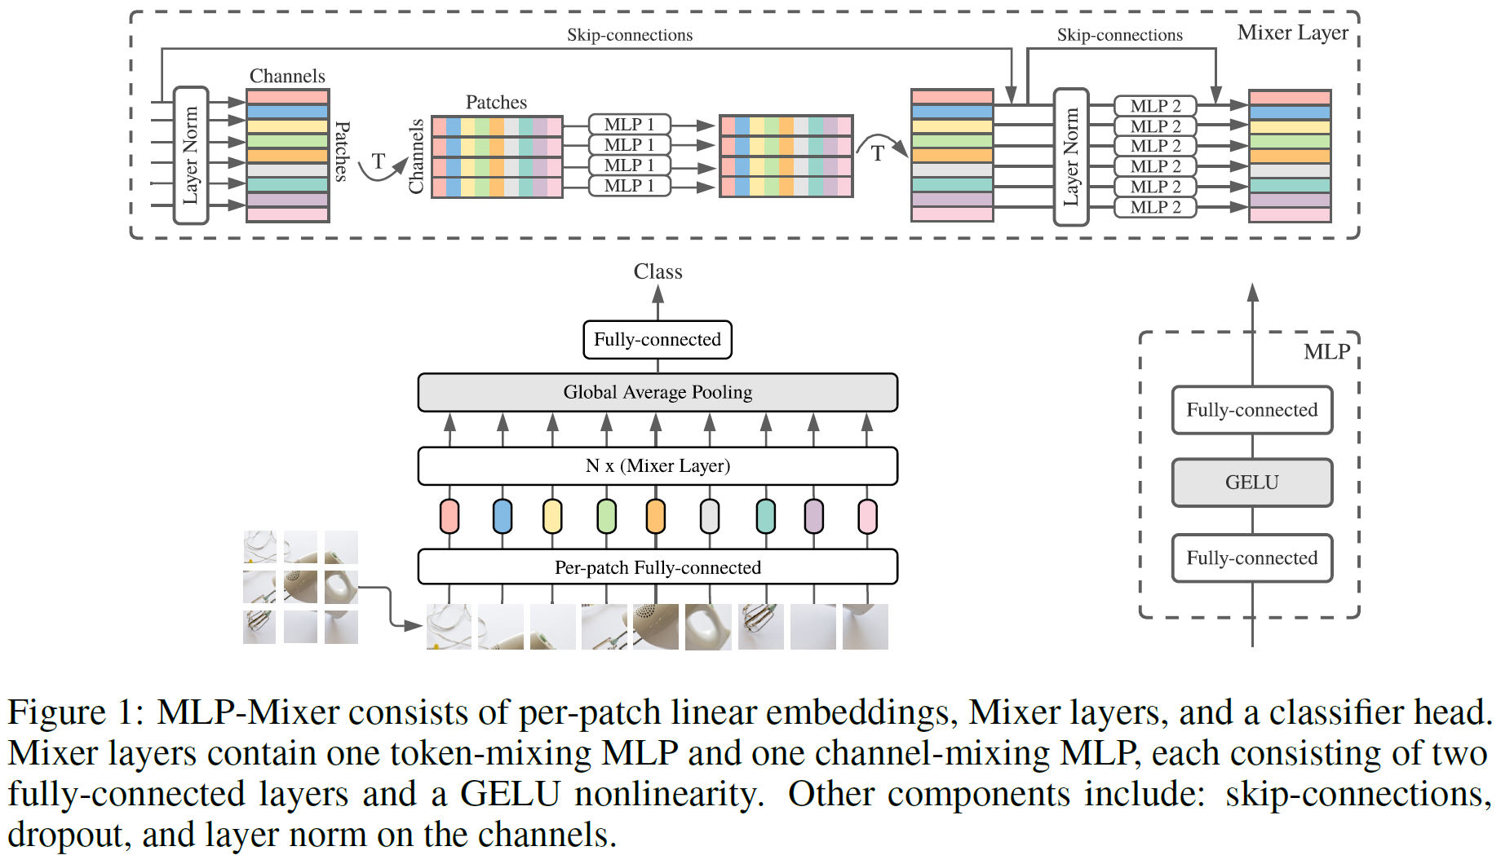
Pure MLP Models

Slide 5
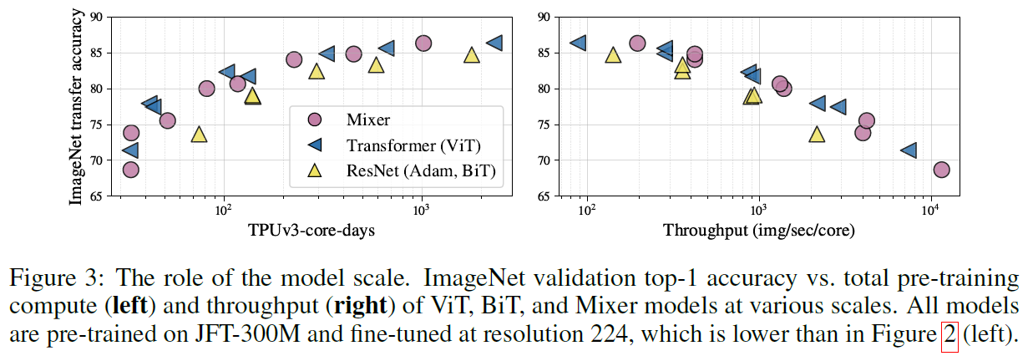
Pure MLP Models

Slide 6
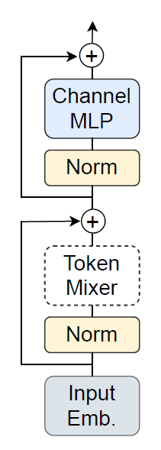
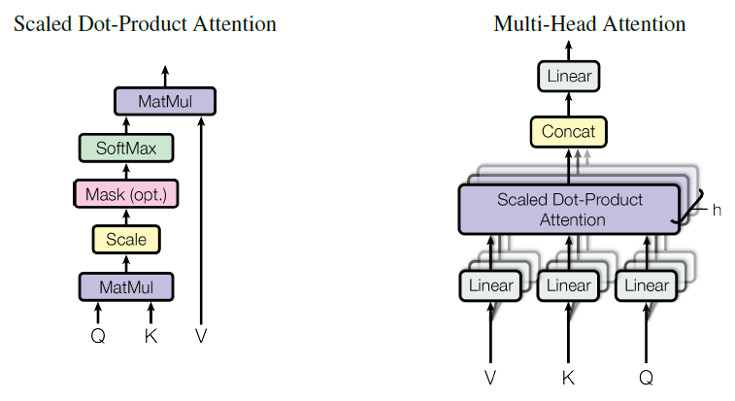

Generalization
Given $X∈ℝ^{HW×D}$,
Convolution:
$X_{i}←Conv\left(X_{i},M_{i}^{conv}\right)$
$M_{i}^{conv}∈ℝ^{K×K}$
Vision transformers:
$M^{att}=softmax\left(\frac{XW^{Q}{\left(XW^{K}\right)}^{T}}{\sqrt{d_{K}}}\right)$
$X←M^{att}XW^{V}$
$M^{att}∈ℝ^{HW×HW},W∈ℝ^{D×D}$
MLP models:
$X←M^{mlp}X$
$M^{mlp}∈ℝ^{HW×HW}$

Slide 7
GFNet

Slide 8
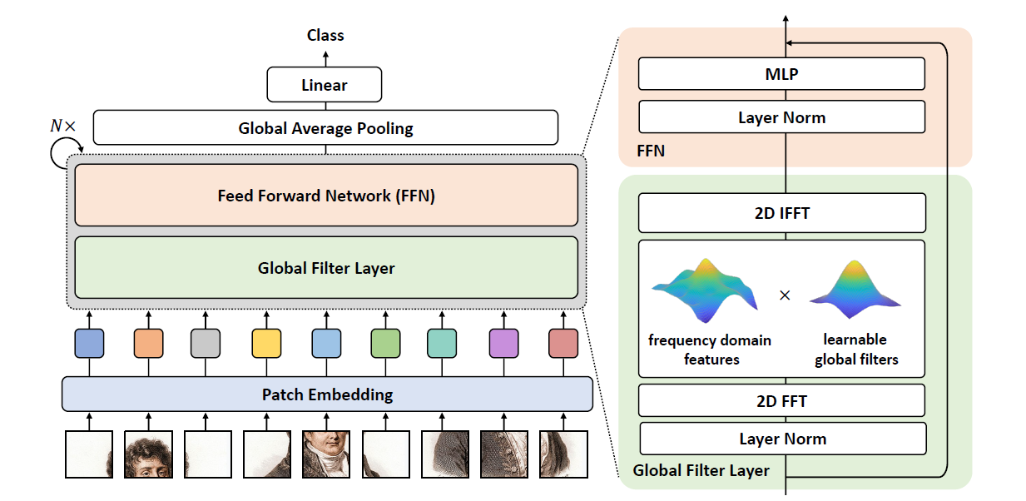
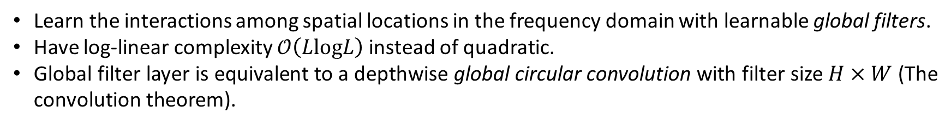
Global Filter Networks
The overall architecture
Learn the interactions among spatial locations in the frequency domain with learnable global filters.
Have log-linear complexity $𝒪\left(LlogL\right)$ instead of quadratic.
Global filter layer is equivalent to a depthwise global circular convolution with filter size $H×W$ (The convolution theorem).

Slide 9
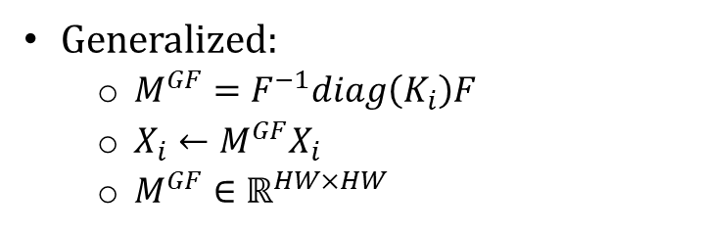
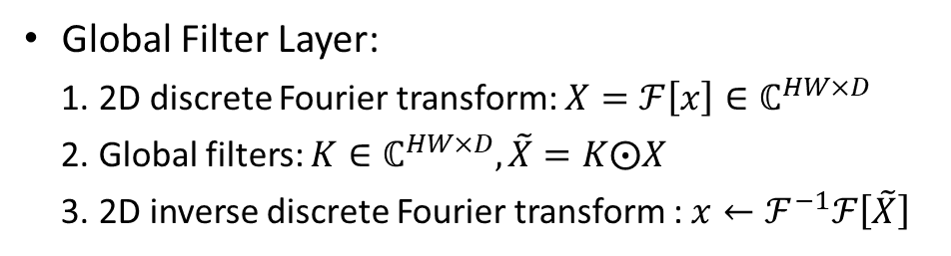
Global Filter Networks
The overall architecture
Global Filter Layer:
2D discrete Fourier transform: $X=ℱ\left[x\right]∈ℂ^{HW×D}$
Global filters: $K∈ℂ^{HW×D},\tilde{X}=K⨀X$
2D inverse discrete Fourier transform : $x←ℱ^{−1}ℱ\left[\tilde{X}\right]$
Generalized:
$M^{GF}=F^{−1}diag\left(K_{i}\right)F$
$X_{i}←M^{GF}X_{i}$
$M^{GF}∈ℝ^{HW×HW}$

Slide 10
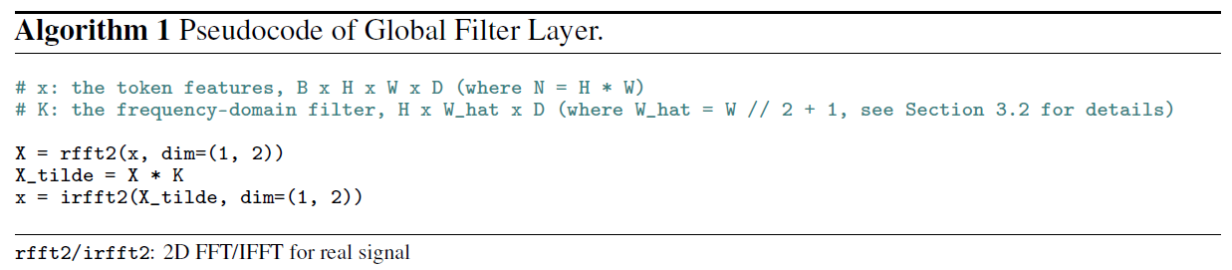
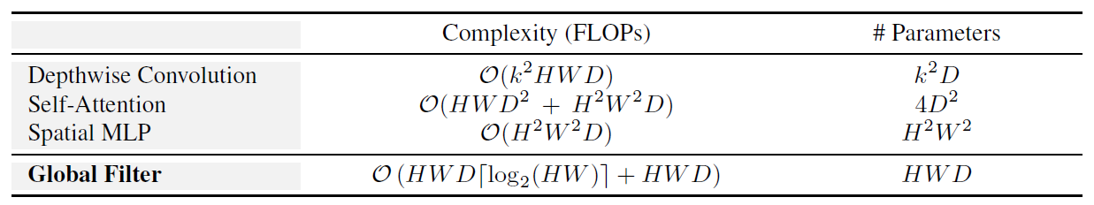
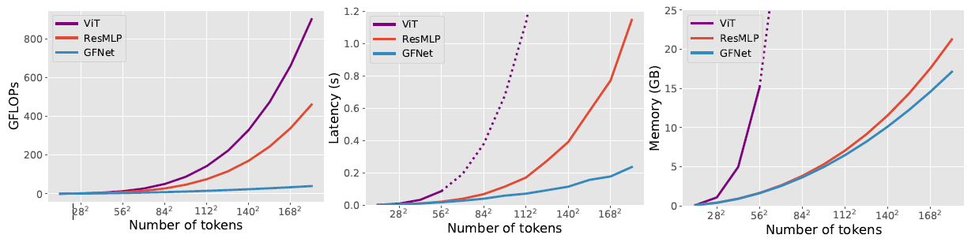
Global Filter Layer

Slide 11
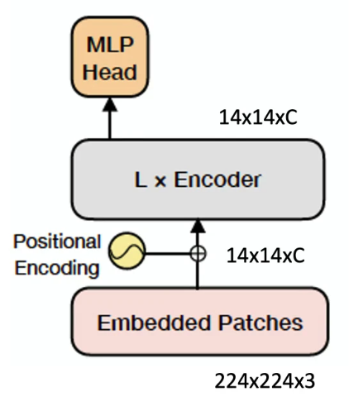
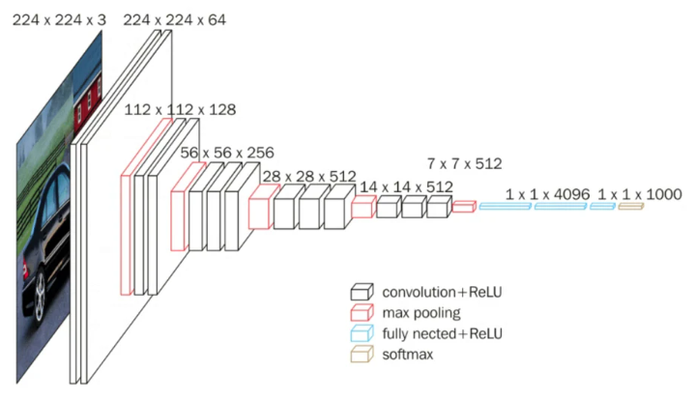
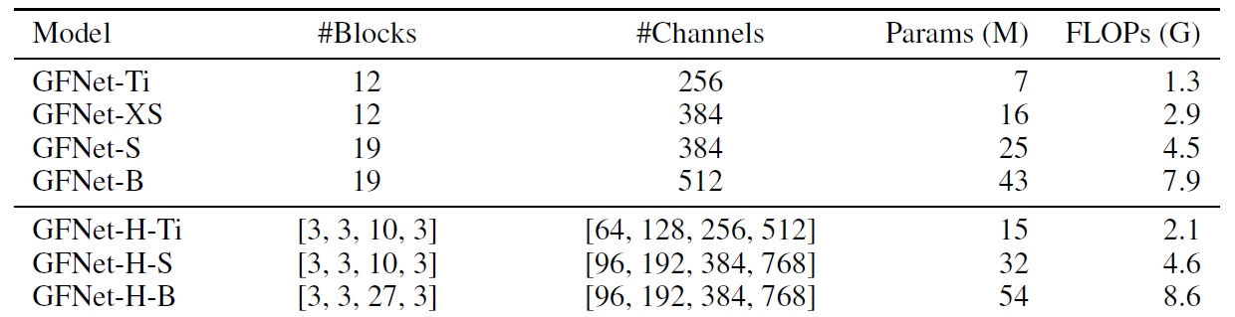
Global Filter Networks
Transformer-style architecture
CNN-style/hierachical architecture
Model configurations

Slide 12
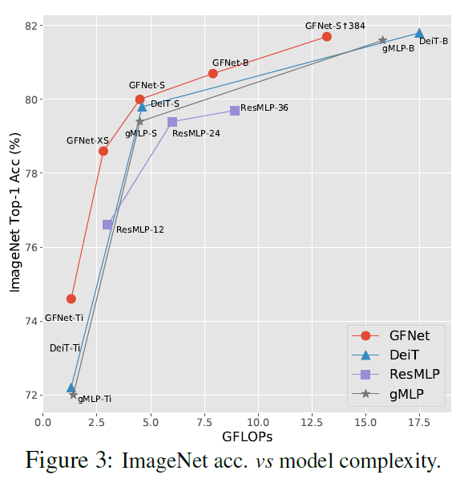
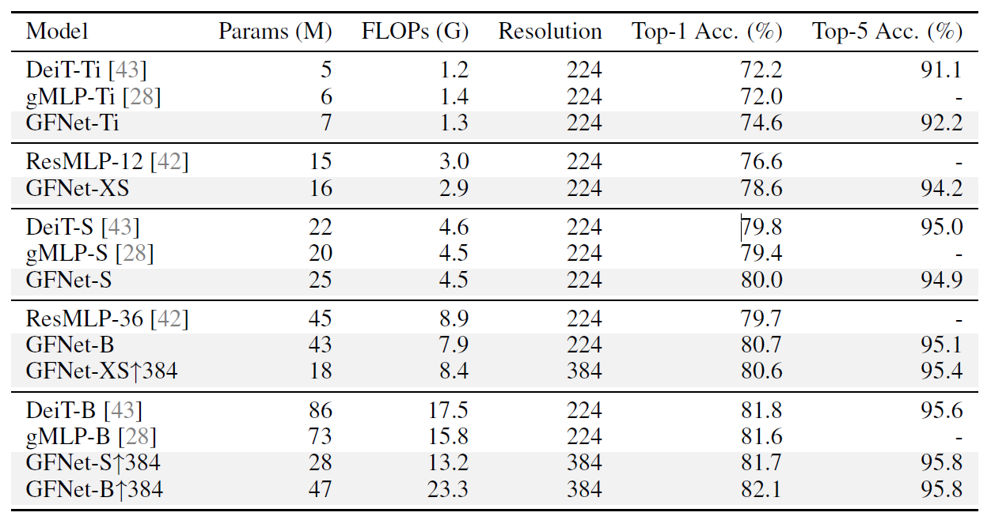
ImageNet Classification
Transformer-style architecture

Slide 13
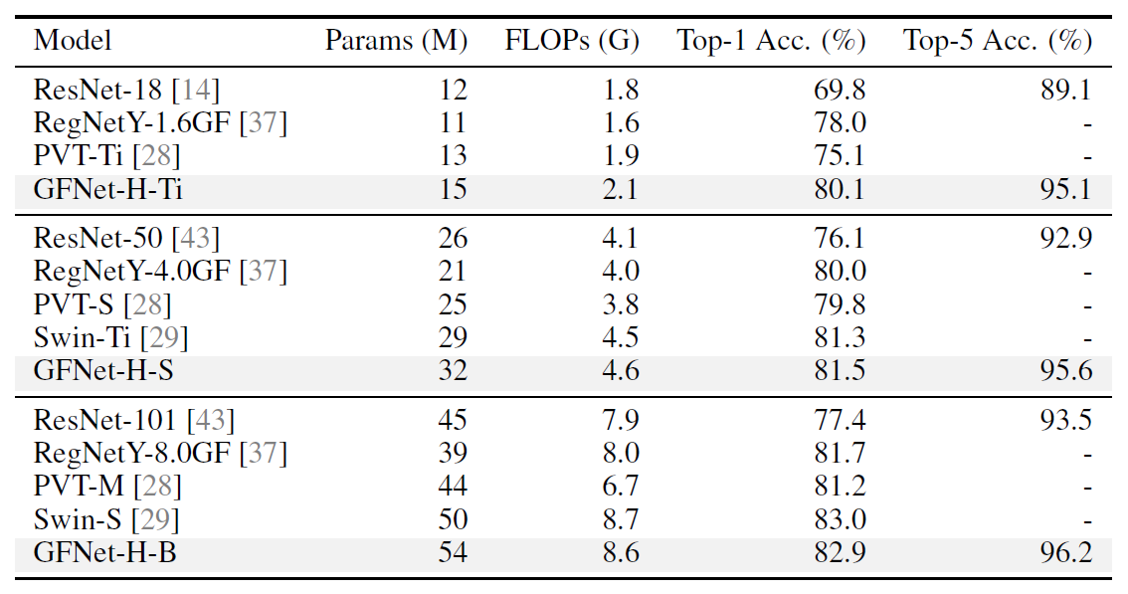
ImageNet Classification
CNN-style/hierachical architecture

Slide 14
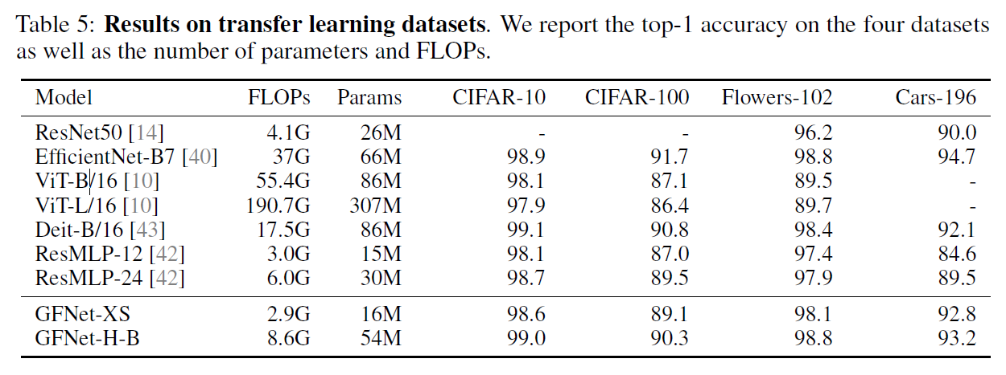
Transfer Learning

Slide 15
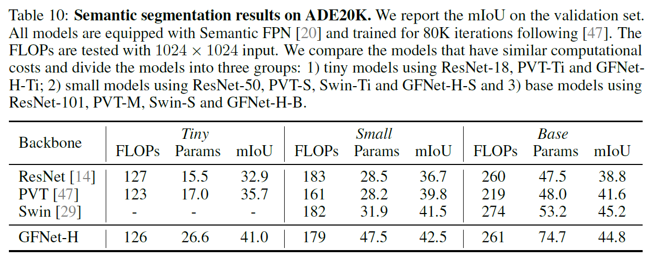
Downstream Task

Slide 16
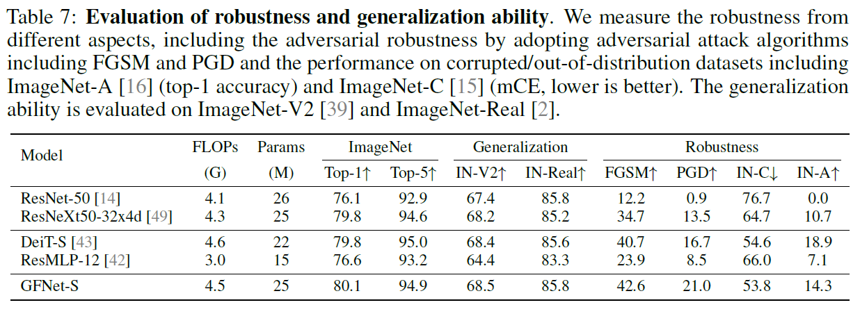
Robustness

Slide 17
GFNet:
A transformer-style architecture that learns long-term spatial dependencies in the frequency domain with log-linear complexity.
A very competitive alternative to transformer-style models and CNNs in efficiency, generalization ability and robustness.

Slide 18
MetaFormer

Slide 19
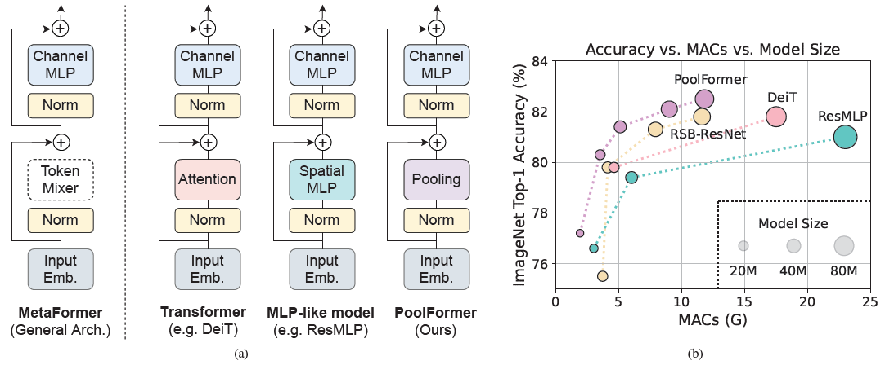
MetaFormer
Hypothesis: Instead of the specific token mixer, the general architecture, termed MetaFormer, is more essential for the model to achieve competitive performance.
Verification: Specify the token mixer as an extremely simple operator, pooling, and find the derived model PoolFormer outperforms well-tuned Vision Transformer/MLP-like/ResNet baselines.

Slide 20
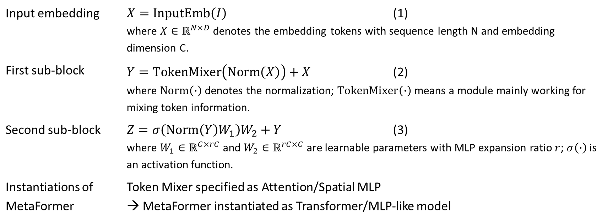
MetaFormer
MetaFormer is a general architecture where the token mixer is not specified while the other components are kept the same as Transformers.
Input embedding | $X=InputEmb\left(I\right)$ (1) where $X∈ℝ^{N×D}$ denotes the embedding tokens with sequence length N and embedding dimension C.
First sub-block | $Y=TokenMixer\left(Norm\left(X\right)\right)+X$ (2) where $Norm\left(∙\right)$ denotes the normalization; $TokenMixer\left(∙\right)$ means a module mainly working for mixing token information.
Second sub-block | $Z=σ\left(Norm\left(Y\right)W_{1}\right)W_{2}+Y$ (3) where $W_{1}∈ℝ^{C×rC}$ and $W_{2}∈ℝ^{rC×C}$ are learnable parameters with MLP expansion ratio $r$; $σ\left(∙\right)$ is an activation function.
Instantiations of MetaFormer | Token Mixer specified as Attention/Spatial MLP → MetaFormer instantiated as Transformer/MLP-like model

Slide 21
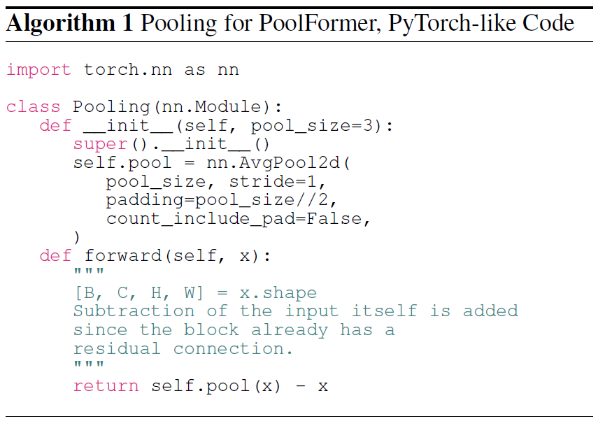
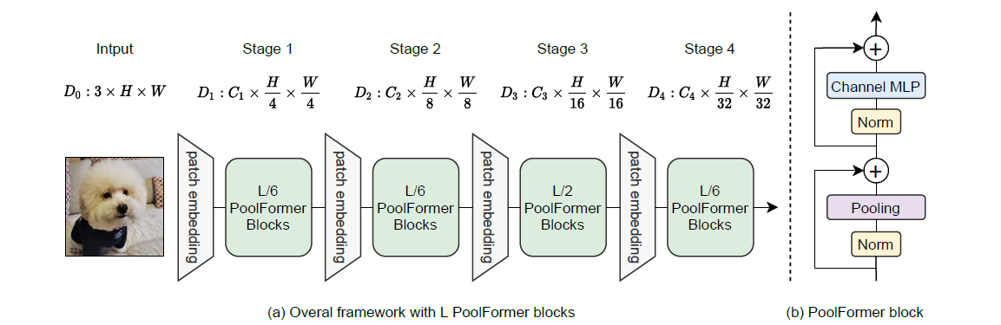

PoolFormer
Pooling Token Mixer (linear complexity):
For input $T∈ℝ^{H×W×C}$
$T_{i,j,:}^{′}=\frac{1}{K×K}\sum_{p,q=1}^{K}{T_{i+p−\frac{K+1}{2},i+q−\frac{K+1}{2},:}}−T_{i,j,:}$ (4)
where K is the pooling size.

Slide 22
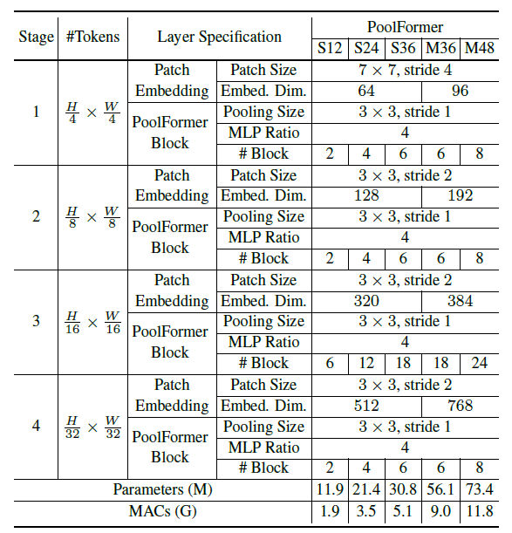
PoolFormer
Model Configurations:

Slide 23
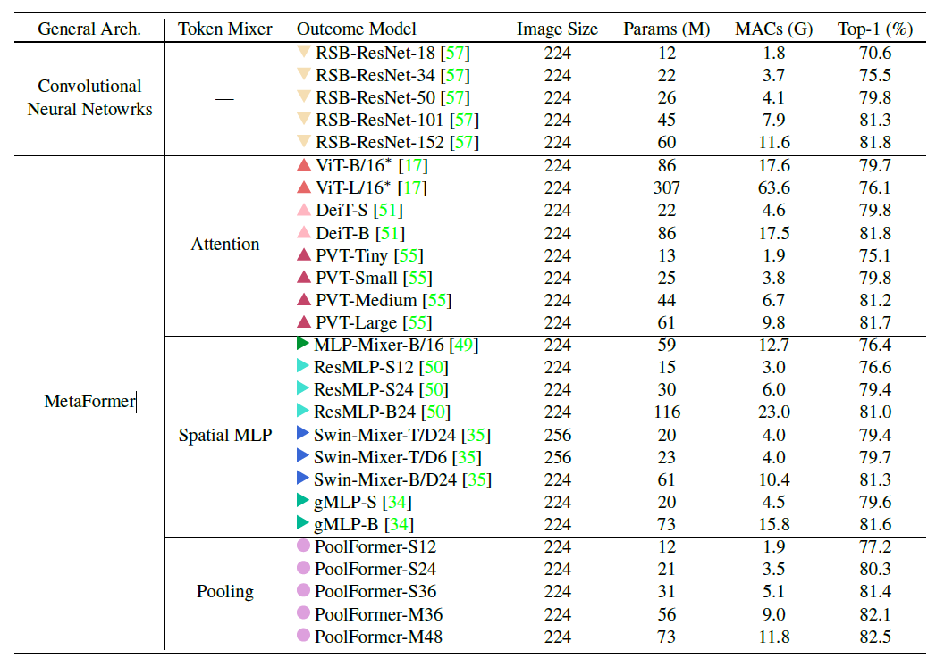
ImageNet Classification

Slide 24
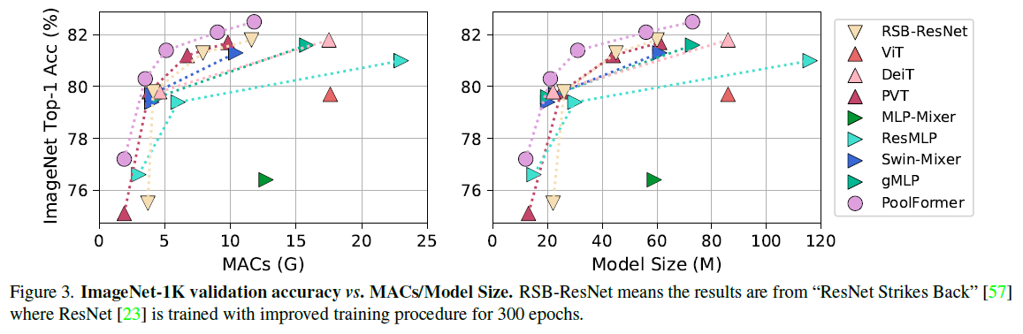
ImageNet Classification

Slide 25
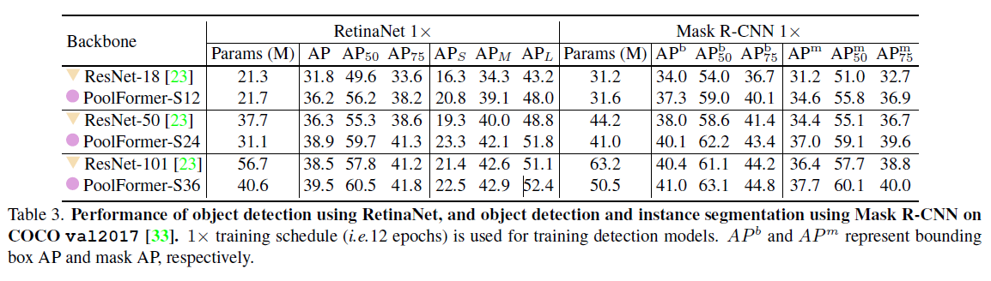
Downstream Tasks
COCO object detection:

Slide 26
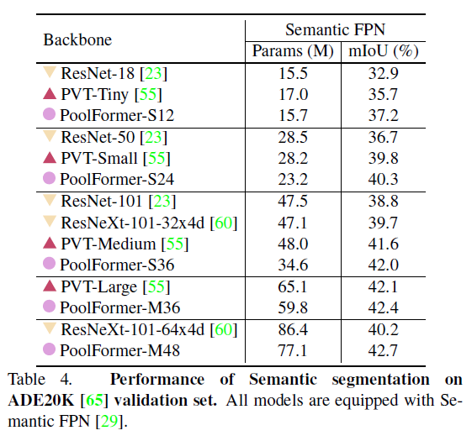
Downstream Tasks
ADE20k semantic segmentation:

Slide 27
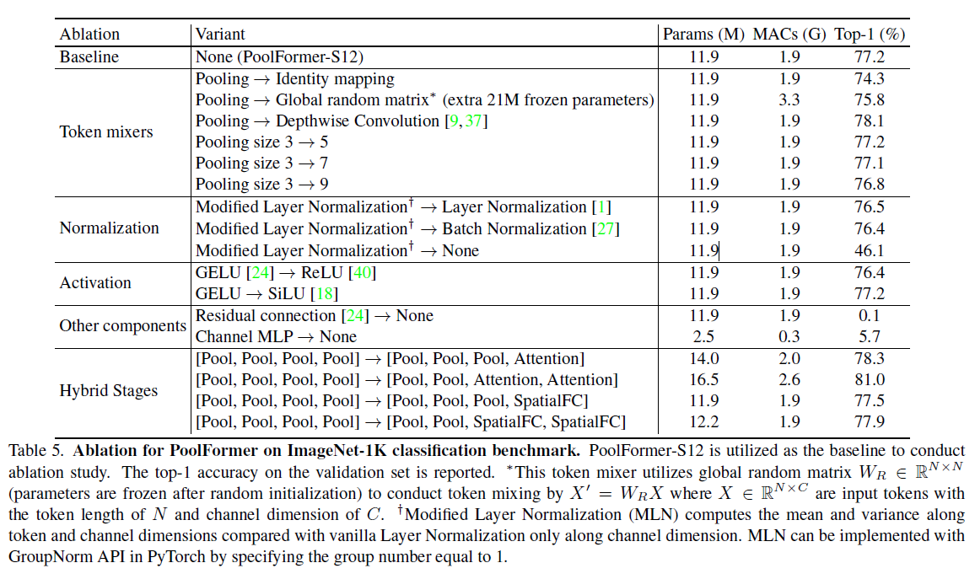
Ablation

Slide 28
MetaFormer & PoolFormer
MetaFormer: transformer-like architecture with the attention abstracted as a token mixer.
PoolFormer: MetaFormer with pooling as the token mixer, can achieve competitive performance on different vision tasks.
MetaFormer Baselines for Vision, arXiv 10/2022:
IdentityFormer block: identity mapping token mixer.
RandFormer block: global random mixing token mixer.
ConvFormer block: separable depthwise convolution token mixer.
StarRELU: more accurate and more efficient than GELU.

Slide 29
Thank you for your attention

